Slide 1
Salesforce Platform
App Innovation Workshop
Brian McCall
Peter Conroy
Platform Technical Architect
Platform Solutions Specialist

Slide 2
Agenda
Introductions
Salesforce Platform
What’s an App?
Deal Support Request MVP App - Demo
Deal Support Request MVP App – Looking Under The Hood
Q&A and Next Steps

Slide 3
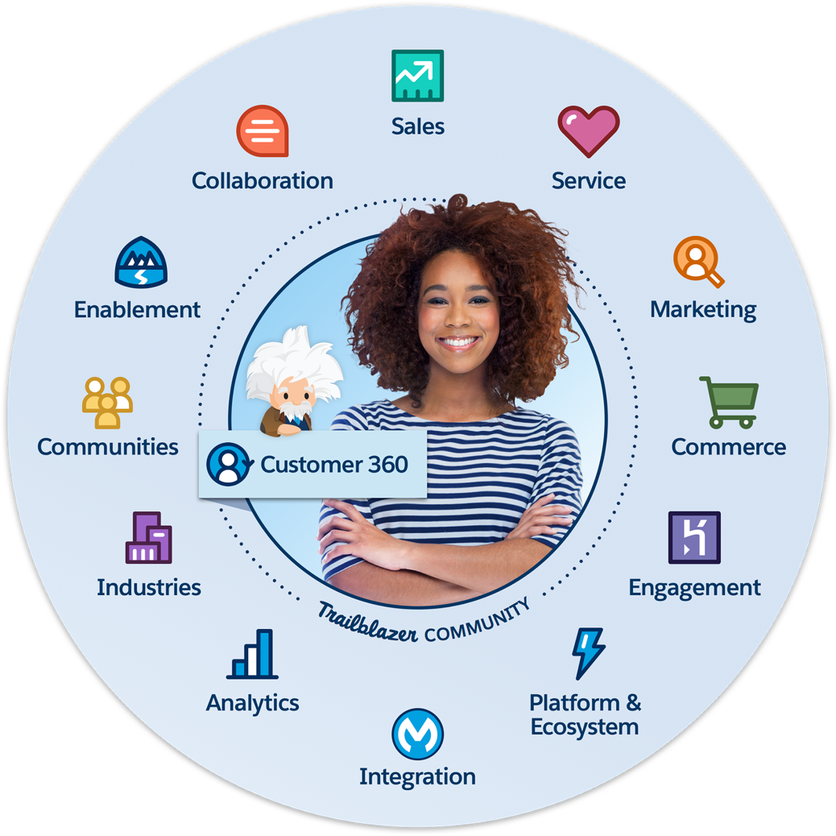

Customer Success Platform
Connect to your customers in a whole new way
Notes:
Key Message
Companies need deeply relevant and personalized interaction across devices, channels and interactions
The Customer Success Platform is how companies create a single view of their customer
Talk Track Our Customer Success Platform is how we help our customers succeed. We help connect companies to their customers across Sales, Service, Marketing, Commerce, and across every customer touchpoint.

Slide 4
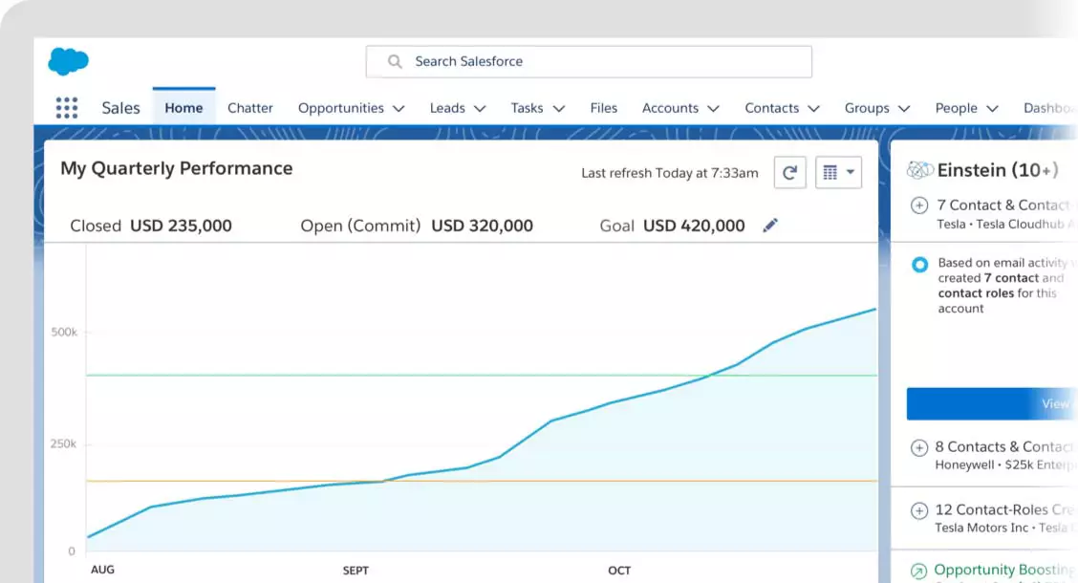
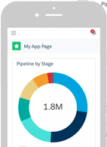
What is an app?
An app is a collection of items that work together to serve a particular business function.
Apps may include:
Data model
User interface
Business logic and automation
Intelligence
Analytics
Search
Connections to other systems

Slide 5
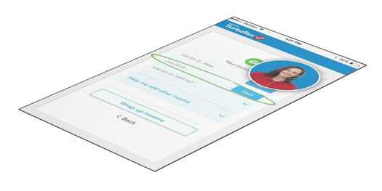

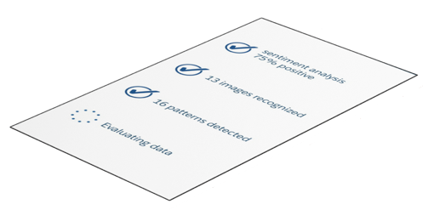
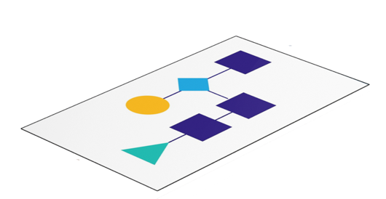
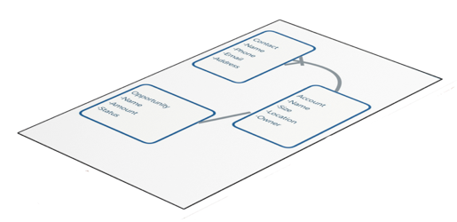
Create Rich Apps and Websites with No Code
Drag-and-drop tools empower declarative developers
User Experience
Lighting App Builder
Lightning Community Builder
Intelligence
Einstein Prediction Builder
Logic
Process and Flow Builders
Data Model
Schema Builder
Rakesh Kumar
Salesforce Admin
Notes:
Key Messages
We are the industry’s leader for empowering declarative developers with no- and low-code tools
Business users are empowered with the Lightning Platform
Talk Track
The Lightning Platform has a whole host of tools for admins and business analysts to build apps without code for every layer of an app
Schema Builder for creating and editing your data model
Lightning Process Builder and Cloud Flow Designer to add rich business logic or ‘flows’ to your app
Einstein Prediction Builder to bake intelligence into your app
Lightning App and Community Builder help you optimize your user interface and experience
Transition All of these tools, let your app dev teams focus on innovating fast, rather than just keeping the lights on

Slide 6











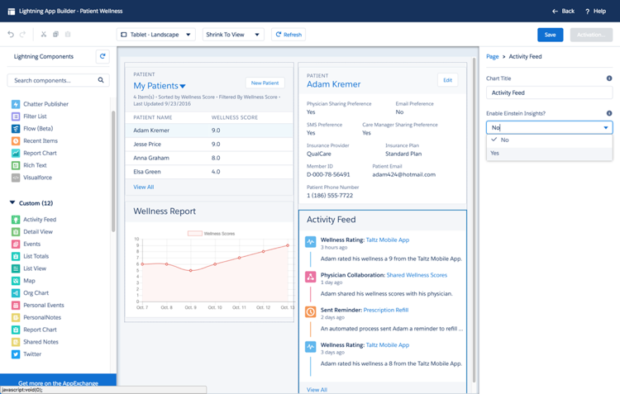

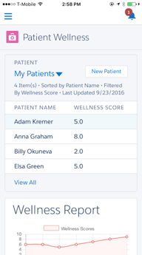



Every App Comes with Powerful Services Built-in
Why build every piece of functionality from scratch?
Artificial Intelligence
Workflow Engine
Security & Access Controls
Collaboration
Multi-Language & Currency
APIs
Mobile Access
Search
Identity
Reports & Dashboards
Notes:
Key Messages
Building engaging, secure and functional apps in today’s changing environment is hard
We have done so much work for you already, so you don’t have to
Talk Track
The Lightning Platform simplifies app dev by abstracting a lot of code and complexity.
Services like identity, collaboration, workflow automation, AI, mobility search and so on, just come standard with any app you build on the Lightning Platform
Why build every piece of functionality from scratch when we’ve already done so much of the work for you?
Transition This is what makes app dev on Salesforce easy.

Slide 7
80%
20%
Clicks
&
Code
Page Layouts
Lightning Apps
Record Types
Lightning Apps
Lightning Pages
Lightning Components
User Interface
Formula Fields
Validation Rules
Workflows and Approvals
Apex Controllers
Apex Triggers
Business Logic
Custom Objects
Custom Fields
Relationships
Metadata API
REST API
Bulk API
Data Model

Slide 8
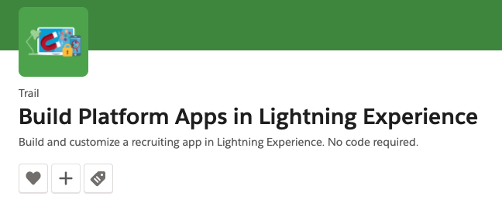
Trailhead – The Free & Easy Way To Learn Salesforce
https://trailhead.salesforce.com/en/content/learn/trails/build-platform-apps-in-lightning-experience

Slide 9
Demo
What You’ll See:
- DSR MVP App
- Sales request help on opportunity
- Centralized request management with Queues
- Expert assignment from Queue
- Sales self-service view DSR status
- Mobile DSR MVP App
- DSR reporting
- DSR app components & automation

Slide 10
Notes:
Key Messages
Heroku lets you easily extend what you already have built on Salesforce
Heroku reigns supreme for web-scale apps that help complete your 360-degree view of the customer
Talk Track
If you’re looking to give your development team complete flexibility in their app dev process, we have Heroku
Heroku lets developers build apps in the languages and frameworks they know and love
Any app built in Heroku can be instantly connected to Salesforce through Heroku Connect, ensuring the 360-degree view of your customer is maintained and built upon
Heroku has all of the enterprise-grade security you’d expect from Salesforce, letting your IT team ensure the development of highly secure and compliant apps across industries
Transition So that’s a little about, what’s in the Lightning Platform…

Slide 11
DSR Object
Automation
Fields
Fields
Fields
Fields
Fields
Fields
Fields

Slide 12
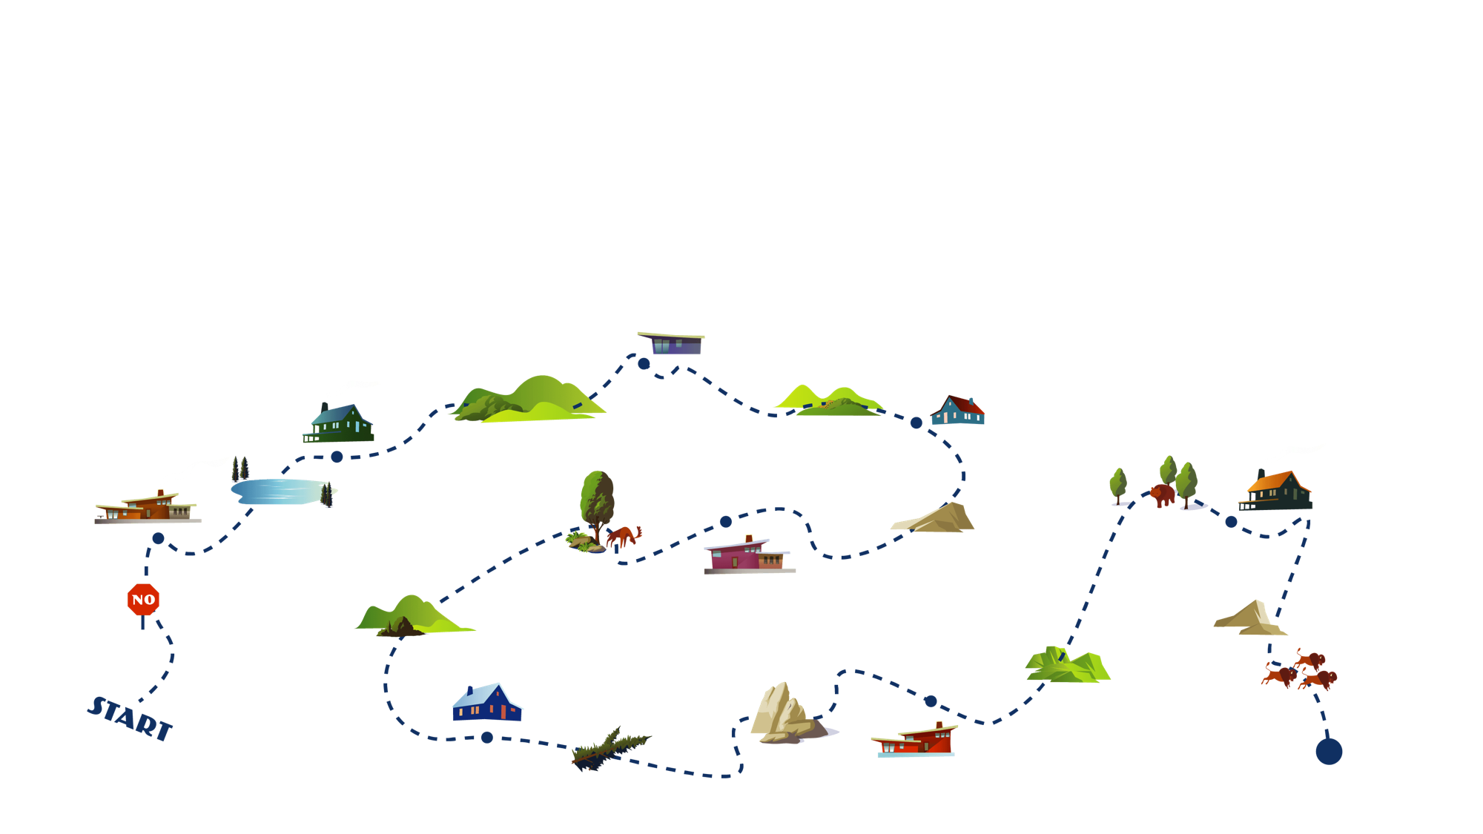

What if you Wanted to Build an App?
Traditional platforms aren’t designed to empower anyone
Gather Requirements
Build Project Plan
Secure Developer
Meet with IT
QA Testing
Procure Infrastructure
Security and Compliance
App Deployed
Build

Slide 13





Salesforce is the Fastest Path from Idea to App
So you can focus on building experiences people love
Salesforce
Other Platforms
Network
Infrastructure
Operations
User Experience
Apps
Notes:
Key Messages
Salesforce is the fastest path from idea to app
Talk Track
Salesforce gives you everything you need to build apps fast and get started right away, right out of the box.
Instead of buying and setting up hardware, software, networking, and piecing together a dev stack, you can focus on solving the business problem. All of the platform services that underpin our CRM offerings are available to you for your apps with rapid dev tools to define your data schema, your sharing model, workflow, collaboration, reporting and dashboards, and your UI.
It’s your fastest path from idea to app.

Slide 14






Salesforce Changes How You Approach App Development
Where do you want to spend your time?
Apps
Apps
Time
Operations
Operations
Infrastructure
Infrastructure
Legacy Platforms
Salesforce
Notes:
Key Messages
The Lightning Platform changes how you do app development by allowing you to focus on building apps, while Salesforce handles the rest
Talk Track
The Lightning Platform allows you to change how you approach app development. Some companies are still building on legacy technology. When you buy legacy technology, like on premise system, you have to manage things you don't have to with Salesforce—like infrastructure and operations-- leaving very little time for building apps. With Salesforce, we manage the infrastructure and provide tools for the operations, so you can focus on building apps and not worry about infrastructure and operations, as we handle that for you. Transition
Something that we have that our competitors do not...

Slide 15
Building Apps with Salesforce
Notes:
Transition App builder, process builder, connect, flow, community builder

Slide 16



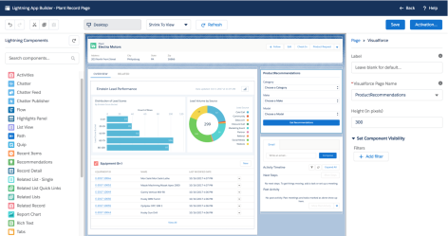
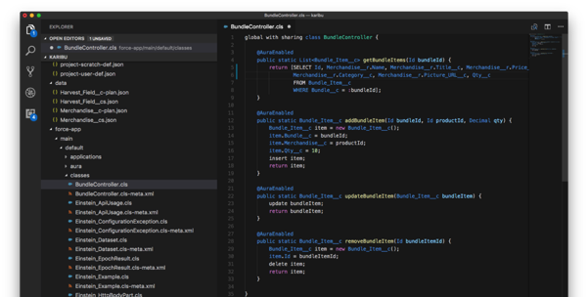

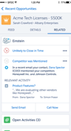

Empower Everyone to Build Apps and Experiences
One platform for your customers, partners and employees
Lightning Community Builder
Lightning App Builder
Salesforce DX
LOW-CODE
AppExchange
Heroku
NO-CODE
CODE
Toya Gatewood
Salesforce Admin
Jordan McDaniel
Developer & Architect
BUSINESS USERS
DEVELOPERS
Notes:
Key Messages
No-code to code spectrum of products empowers everyone to be a part of the app dev process, decreasing the time to market for innovative ideas
The Lightning Platform lets you build apps fast!
Talk Track
There is a spectrum of technical talent inside companies from end-users of technology through to developers
No matter where you sit on that spectrum, the Lightning Platform has tools for you to succeed in building apps for your customers, partners and employees
This is the key to rapid app dev, your business users and developers work together, on the one platform, to solve business challenges
The Lightning Platform has no-code tools for declarative developers like Salesforce admins and business users and tools like Salesforce DX and Heroku for programmatic developers.
Transition Everyone is empowered to build apps fast.

Slide 17

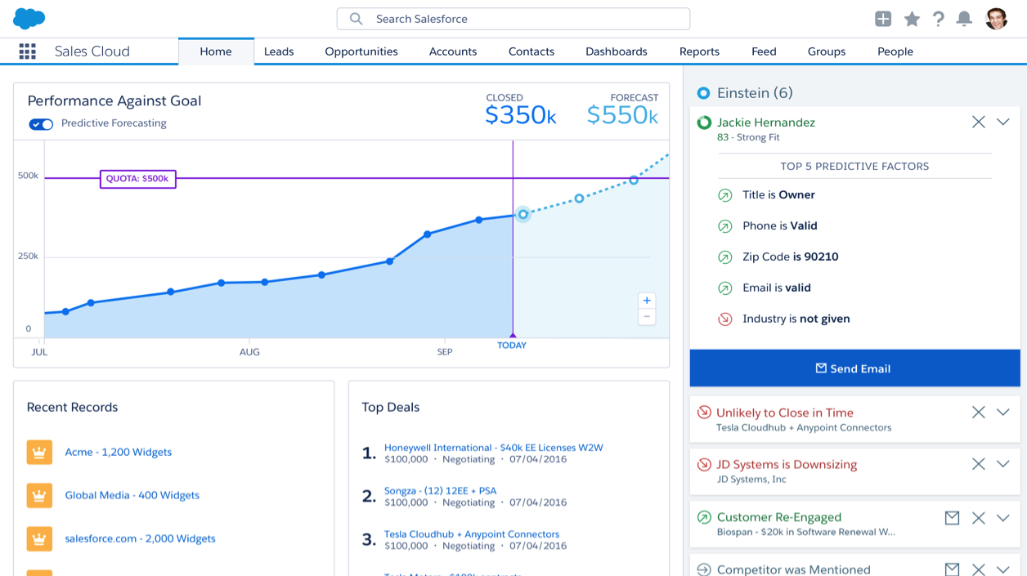
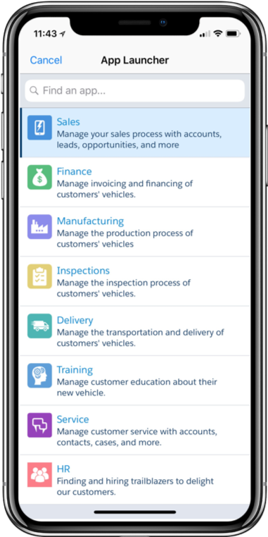
Declarative App Development
Tailor your Salesforce experience with the power of the Lightning Platform
Create Custom Fields
Specify User Access & Permissions
Automate Processes
Relate Objects to Each Other
Consume APIs
Optimize Mobile Experience
Setup Quick Actions
Transition to Lightning Experience
Lightning Platform
Notes:
Developer - Schema Builder, Lightning App Builder, Flow Builder, Process Builder
Key Messages
Customize your org your way
Tailor your Salesforce experience with the power of the Lightning Platform
Talk Track
Everytime you:
Create custom fields
Automate processes
Consume APIs
Setup Quick Actions
Specify user access and permissions
Relate objects to each other
Optimize mobile experience
Transition to lightning experience
You are using the power of the Lightning Platform to tailor your Salesforce experience. You customize your org your way.
Transition
Start customizing your Salesforce experience with...

Slide 18
Create Rich Apps and Websites with No Code
Drag-and-drop tools empower declarative developers
User Experience
Lighting App Builder
Lightning Community Builder
Intelligence
Einstein Prediction Builder
Logic
Process and Flow Builders
Data Model
Schema Builder
Rakesh Kumar
Salesforce Admin
Notes:
Key Messages
We are the industry’s leader for empowering declarative developers with no- and low-code tools
Business users are empowered with the Lightning Platform
Talk Track
The Lightning Platform has a whole host of tools for admins and business analysts to build apps without code for every layer of an app
Schema Builder for creating and editing your data model
Lightning Process Builder and Cloud Flow Designer to add rich business logic or ‘flows’ to your app
Einstein Prediction Builder to bake intelligence into your app
Lightning App and Community Builder help you optimize your user interface and experience
Transition All of these tools, let your app dev teams focus on innovating fast, rather than just keeping the lights on

Slide 19
Data Model
Notes:
Transition App builder, process builder, connect, flow, community builder

Slide 20









App Dev on the Lightning Platform Starts with Objects
Two types of objects are ‘standard’ and ‘custom’
Standard Objects
Comes Out-of-The Box
Custom Objects
Tailor to Suit your Organization
Accounts
Contacts
Tasks
Equipment
Projects
Applicants
Leads
Opportunities
Cases
Inspections
Property
Shipments
Notes:
Many of you are familiar with app dev on the platform, and so you know it begins with objects
We have standard objects, that come out-of-the-box ready to use and we have custom objects that you can build specific to your organization's needs
That brings us to the question...

Slide 21

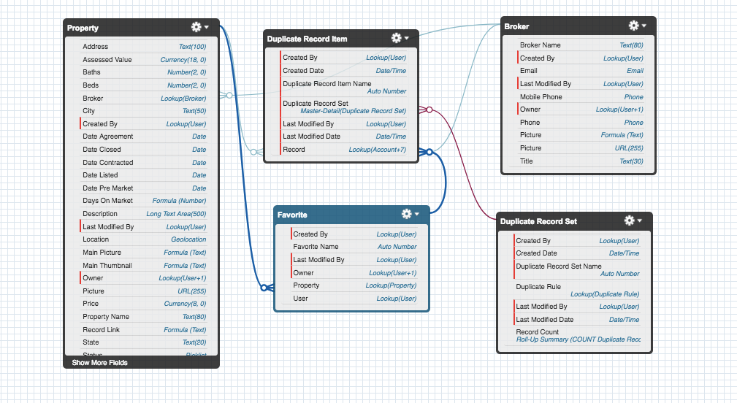


Schema Builder
Design your connected data model without code
Map Data Visually
Add new custom objects and fields, and orchestrate their relationships visually
Edit in Real-Time
Modify your data model in minutes
Make your Data Easily API-Accessible
Give pro devs access to your data through automatically created API end-points
Look for these icons. They are the specific Trailhead badges available at:
trailhead.salesforce.com
Data Modeling

Slide 22
Salesforce Objects
Similar to Tables (with more metadata)
Standard objects out-of-the-box
Account, Contact, Opportunity, …
You can add custom fields to standard objects
Rating__c, Twitter__c, …
You can create custom objects
i.e. Speaker__c, Session__c, Hotel__c
Custom objects have standard fields
Id, Owner, LastModifiedDate, LastModifiedBy, …

Slide 23
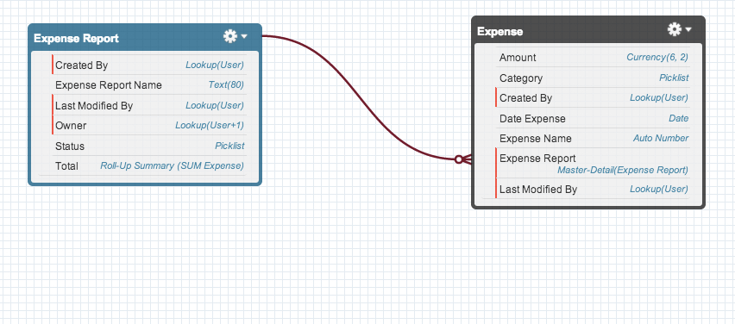
Modeling One-to-Many Relationships
An expense report has many expenses
An expense has one expense report
Notes:
Could you define the conference data model using a one-to-many relationship between Session and Speaker?
No! Because a speaker can have many sessions, but a session can also have many speakers: we need a many-to-many relationship.

Slide 24
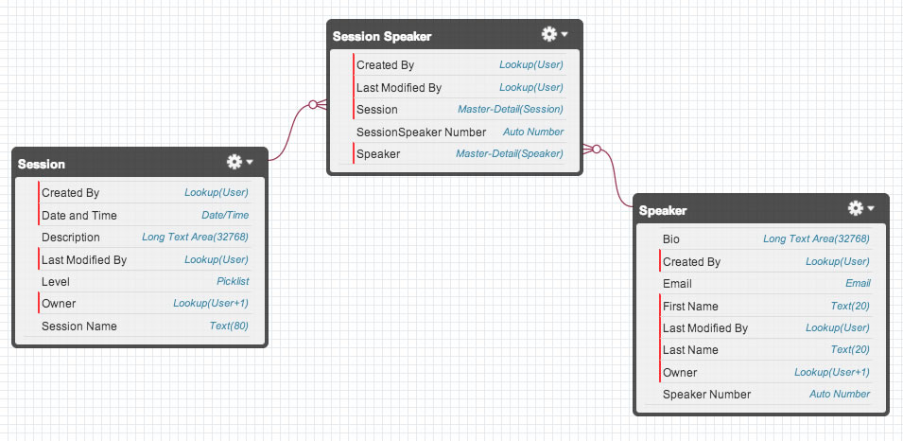
Modeling Many-to-Many Relationships
A session can have many speaker assignments
A speaker can have many session assignments
Notes:
To model a many-to-many relationship you need to introduce a new object, called junction object. We call it Session_Speaker because it joins sessions and speakers. It may be useful to think about it as the "Booking" or "Assignment" object. To model the many-to-many relationship, you then define a one-to-many relationship between Session and Session_Speaker, and then between Speaker and Session_Speaker.

Slide 25
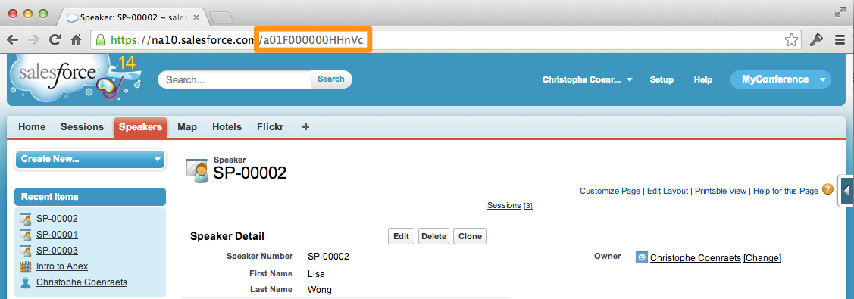
Id
All objects are given an Id field
Globally unique Id is assigned at record creation
"Primary key" used to access records

Slide 26
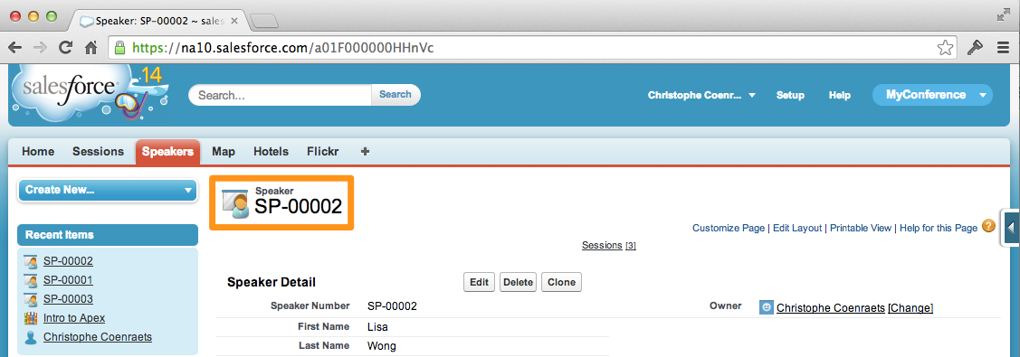
Record Name
Human readable / logical identifier
Text or Auto Number ("Intro to Apex" or SP-00002)
Uniqueness not enforced

Slide 27

When you create an Object, you get…
A CRUD user interface
Instant Mobile App access
A REST API
Rich Metadata
Indexed search
Notes:
HANDOVER TO AC

Slide 28
Declarative Tools

Slide 29
Declarative Logic Features: An Overview
Declarative Feature | Purpose
Validation Rules | Enforce data integrity within or across fields on a record
Formula Fields | Calculate the value of a field based on other fields from the same or related records
Roll-up Summary Fields | Summarize detail records on the master record
Approval Processes | Route records to approvers based on criteria, track and manage the approval flow
Process Builder | Execute a variety of process actions (update records, email notifications, etc.) based on branching logic
Flow | Create on-screen wizards to guide users through a business process, or use “headless” flows as a visual programming language to execute sophisticated business logic
Auto-response Rules – Queues - Assignment Rules - Lead Conversion - Apex Triggers

Slide 30
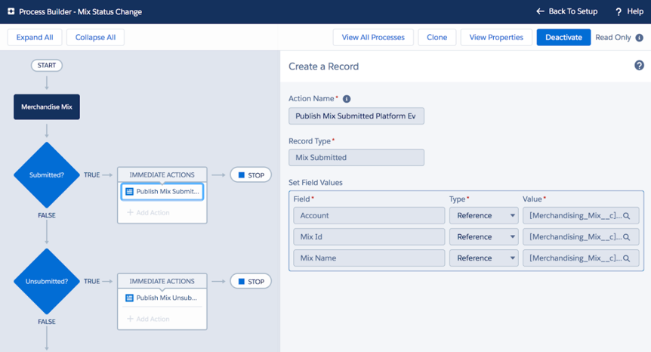

Lightning Process Builder
Easily automate business processes without code
Design Powerful Workflows Quickly
Automate any process with actions and triggers
Configure with Point-and-Click
Develop new processes with an intuitive UI
Extend Processes Anywhere
Deploy workflow once across every device
Process Automation

Slide 31
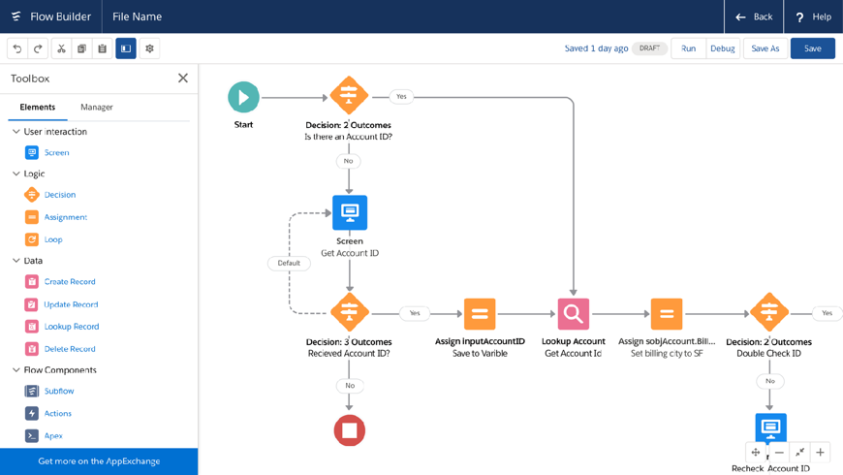

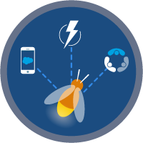
Lightning Flow Builder
Faster, easier, and more intuitive flow building to deliver dynamic apps
Familiar, Intuitive, Accessible
Simplified tool palette, intuitive shapes, and standard form controls make building flows easier than ever
Lightning-Fast Performance
Built with Salesforce’s latest and most performant front-end technologies, you can say goodbye to Flash
No-Code to Code Configuration
Go as far as you can without code, always with the option to write custom code when needed
Screen Flow Distribution

Slide 32

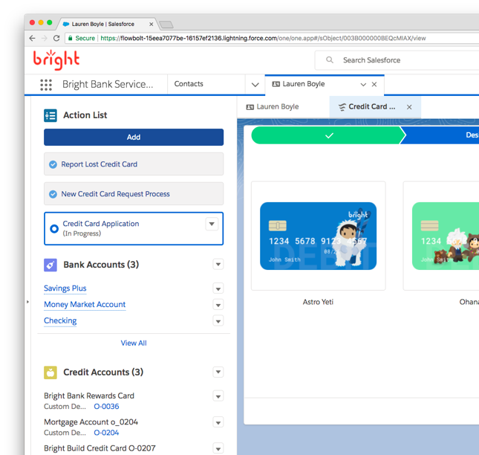
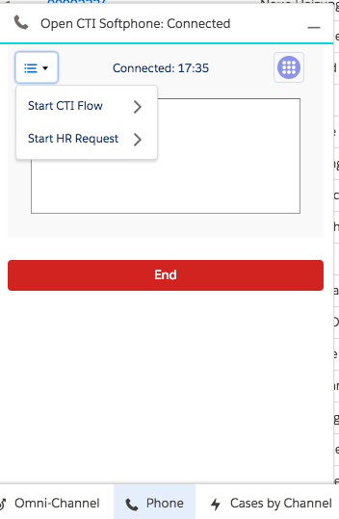
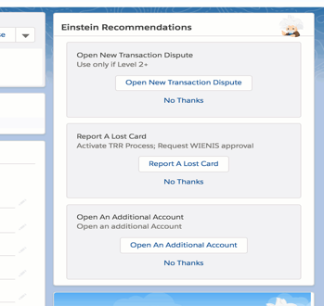
Ways to Launch Flow
Lightning CTI V2
Guided Action Lists
Next Best Actions

Slide 33

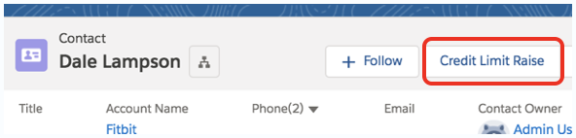
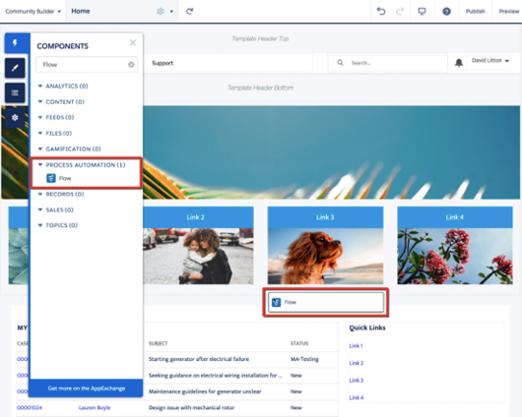
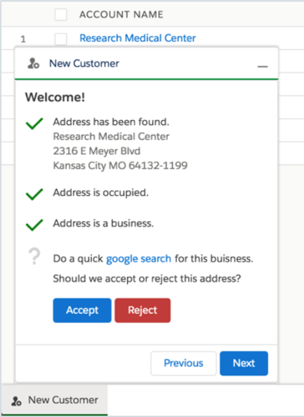
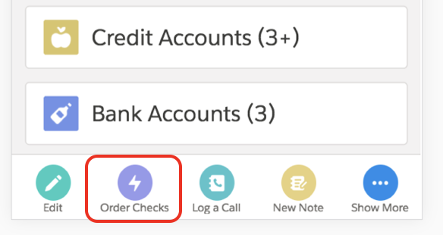
Ways to Launch Flow
Quick Actions
Community Cloud
Utility Bar

Slide 34
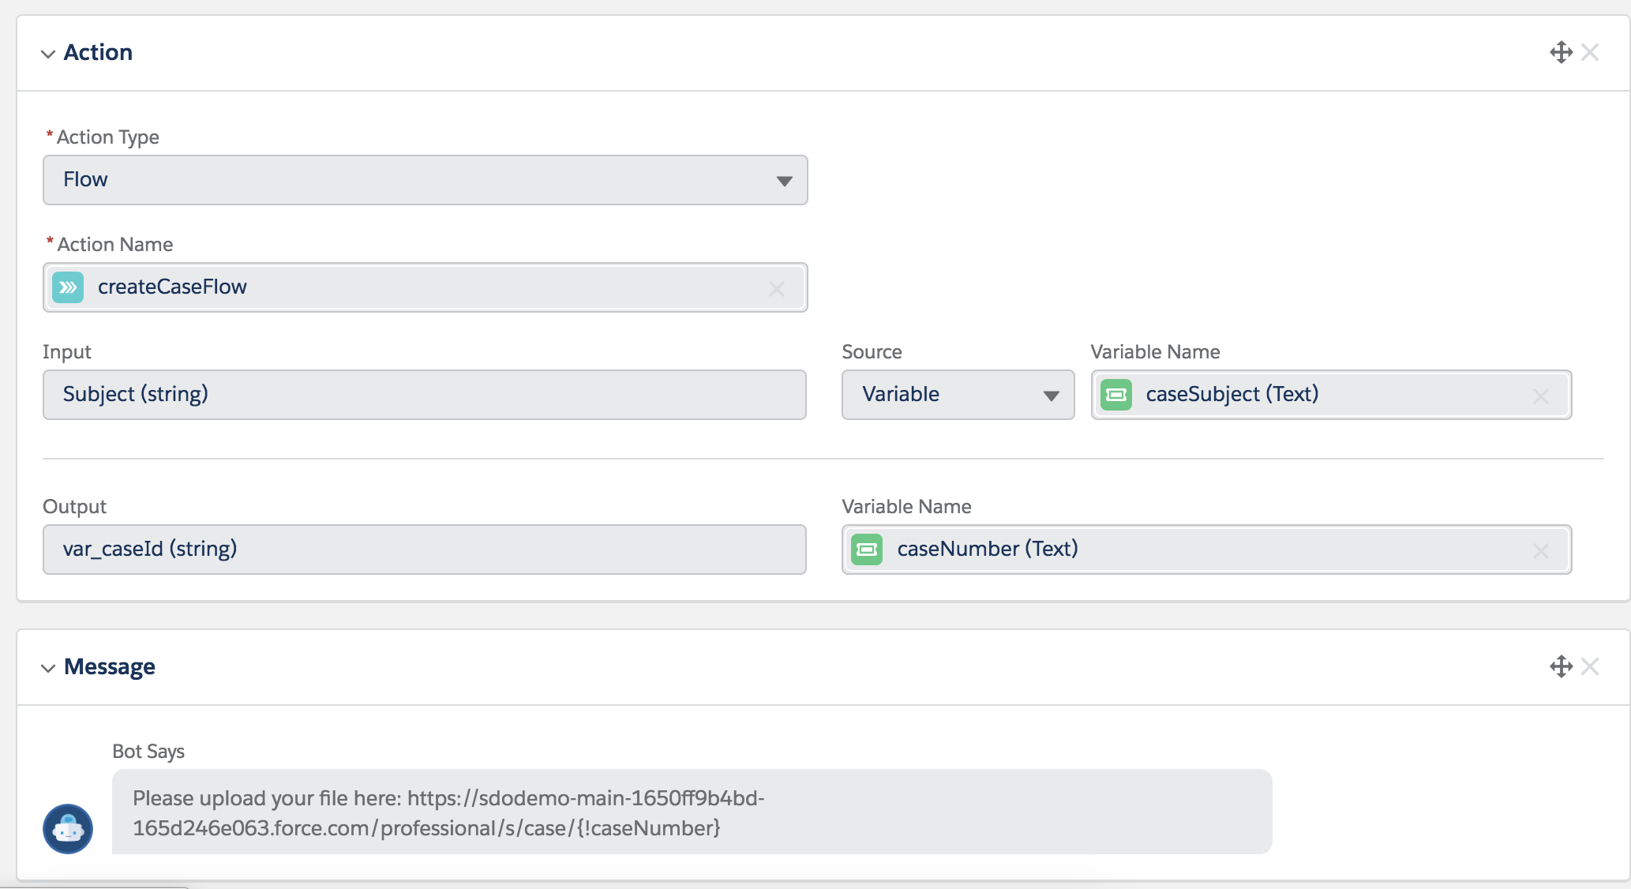
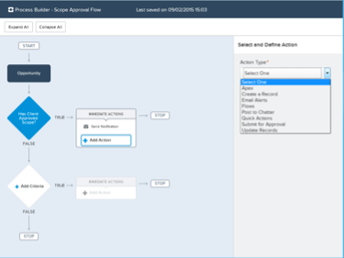
Ways to Launch Flow
BOTs
Process Builder

Slide 35
Automation comparison matrix
Function | Lightning Process Builder | Flows
Auto Fire On Record Create/Update | ✔
Update Fields On Existing Records | ✔ | ✔
Update Fields On Related Records | ✔ | ✔
Create Cross-Object Related Records | ✔ | ✔
Create Cross-Object Non-Related Records |  | ✔
Update Fields On Non-Related Records |  | ✔
Delete Records |  | ✔
Send Auto Emails | ✔ | ✔
Create Auto Tasks | ✔ | ✔
Schedule Time-Based Actions | ✔ | ✔
Create Auto Chatter Posts | ✔ | ✔
Wizard-like Screens To Walk User Through Processes |  | ✔
Submit Record For Approval | ✔ | ✔
Launch A Flow | ✔ | ✔

Slide 36
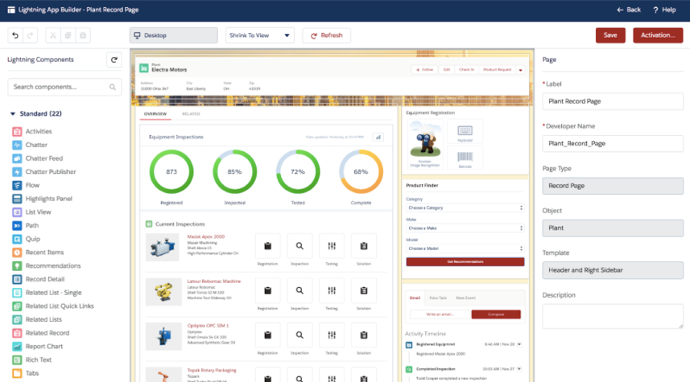

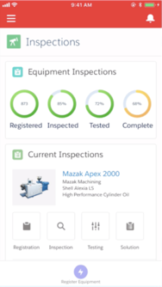
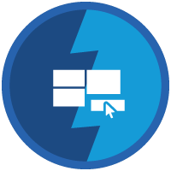


Lightning App Builder
Compose rich apps and pages with drag and drop ease
Build Apps in Minutes not Months
Assemble pre-built components on a visual canvas, bringing concepts to life fast
Unlock the Power of Components
Built by Salesforce, your development team and AppExchange partners
Instantly Available on Mobile
Build your apps once, then access on any device through the Salesforce mobile app
Lightning App Builder

Slide 37


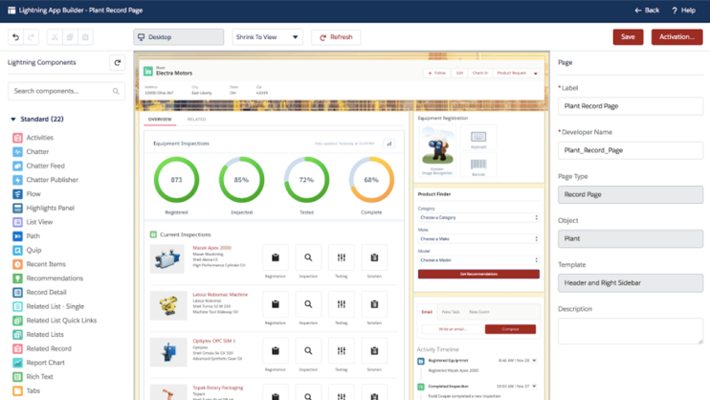
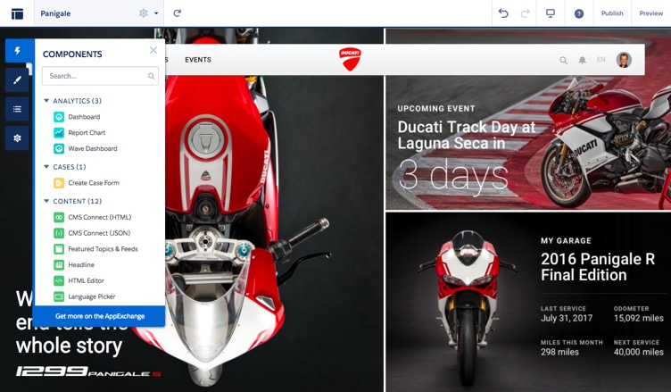






Compose Rich Apps and Pages with Drag-and-Drop Ease
Drag-and-drop tools empower declarative developers
Lightning App Builder
Lightning Community Builder
For Internal Apps
For External Websites and Portals
Notes:
Key Messages
The Lightning Platform has a rich suite of tools to empower programmatic developers to be their best and most productive
Talk Track
You can extend the power of the Lightning Platform with a suite of powerful tools for pro devs
Salesforce DX has reimagined the building, testing and deployment of apps on Salesforce through source-driven development
And Heroku lets developers build in any modern language and comes with it’s own extensible ecosystem of developer productivity add-ons
Transition Onto Salesforce DX…

Slide 38
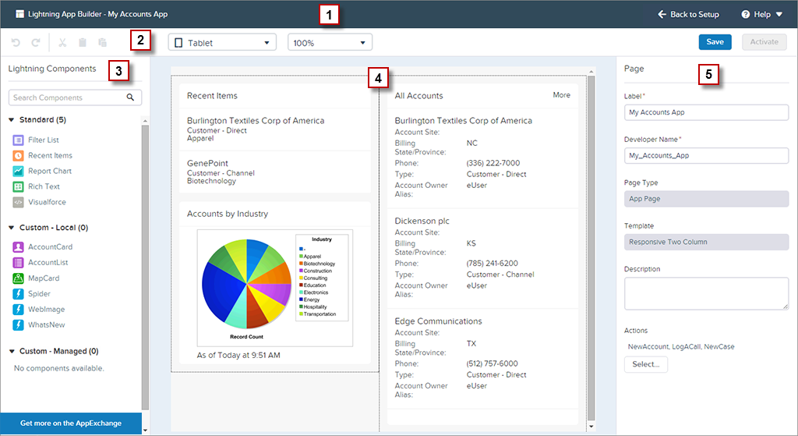
Lightning App Builder Layout
Select the form-factor : Phone, Tablet or Tablet preview mode
Header Pane containing label and navigation
Lightning Components Pane
Properties Pane displaying properties for selected item
Standard components provided by SFDC
Custom Lightning Components built by developers or ISVs
Find additional components on AppExchange

Slide 39

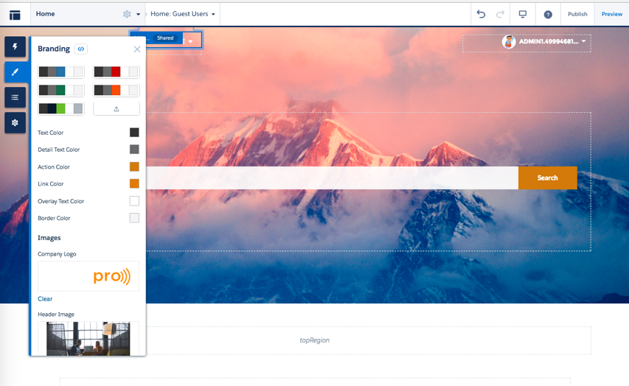

Lightning Community Builder
Custom-brand your customer, partner experience
Build with Clicks not Code
Declarative development with Lightning
Design and Personalize with Ease
Themes, templates and audience targeting
Connect Data, Process, Content
CRM, CMS Connect and Lightning Flow
Extend with an Ecosystem
Partner-built components, apps and industry solutions
Community Cloud Basics

Slide 40
Game Time!
Website:
kahoot.it
Code:

Slide 41
Q&A

